Slide 1
QI Initiative Powepoint
The following is an example of a powerpoint that can be used to present a QI initiative to your team to garner buy in
The slides are presented in pairs
  An informational slide on what should be presented in general terms for any QI initiative
  An example slide of that information presented using the 37.0 rewarming example throughout the presentation
For the purpose of this presentation, the example slides are kept short
  For the purpose of a presentation for your team, you should be in depth with the information provided
  There is always only a single slide for the “example to the team” but for your presentations, there will likely almost always be multiple slides for the team
  You want to provide as much information up front as possible to help ensure an educated buy in from the whole team
Ideally, your presentation should be 15-20 minutes and should strike a balance of in depth information without being too granular or losing the interest of the team

Slide 2
Excessive Rewarming
Team Buy in powerpoint example

Slide 3
Start by introducing the problem
What specifically do you want the team to target?
  Is there a trend you’ve noticed or identified
  Is there new research that has been published that identifies a potential practice change
  Are there gaps in the practice that don’t meet AmSECT standards and guidelines that you want to close
Be specific about the target
  Don’t just say you want to target rewarming methods, say that you want to make sure no one exceeds an arterial temperature of 37, etc
  The more specific a target is, the easier it is for people to conceptualize and get on board with

Slide 4
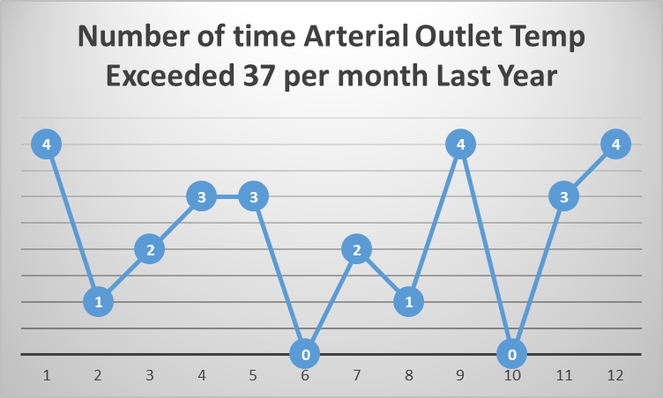
Arterial Blood temps over 37.0c
De-identified data pulled from the past 6 months shows clinicians from the team exceeding an arterial blood outlet temperature of 37.0c on average 2-3 times per month
  This example only works if you have an EMR you can data mine
Include graphs, figures, or the specific data you’re referencing here to show why it’s important or relevant to the team
  Excel is a great place to build a graph or figure if needed. There are great step by step youtube videos if needed.

Slide 5
Why is this something that should be targeted?
What data or research exists to support this intervention?
What ways does this have the potential to improve your practice?
Have there been specific negative outcomes at any point of hospital stay (intra-op, post-op, in the unit, etc) that could be mitigated or improved?

Slide 6
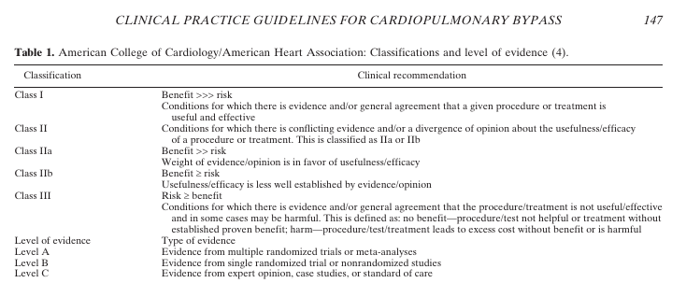
Why is this important for our practice?
Cardiopulmonary Bypass-- Temperature Management during Cardiopulmonary Bypass (2015)
  Clinical practice guidelines regarding temperature management released by AmSECT, STS, and SCA in 2015 providing Class and Level of recommendations for temperature management on bypass
  Class 1, Level C recommendation that arterial outlet temperatures should stay less than 37.0c when on bypass
  Highest level that a guideline can be classified as

Slide 7
Steps to Implementation
What needs to be changed or built into the practice to facilitate this QI initiative?
  Lay out specific steps and timelines
Identify any equipment or resources that will be needed
  Do you have them?
  Have you started the process to get them?
  How long will it take to get them/organize the set up and implementation of them?
What is your ideal timeline?
  Are you starting next week or in 6 months
Does this involve the entire team? Does it involve every patient and operation type? Is there exclusionary criteria?
The more specific you can be with the steps required and what will change in the work flow of each person so they know what to expect, the better chance you have of compliance from the team

Slide 8
Steps to Implementation
Set a high temp alarm on the pumps
  We’re trying to stay below 37 so if we set it to alarm at 36.8 we can catch the water temp before it hits 37
Education
  Please read the temperature guidelines for the background research
  We’ll designate someone (QI leader) to have a conversation with the surgeons about rewarming times
    They might be slightly elevated—we’ll explain why and why its important
When are we starting?
  No outside equipment required
  Can start as soon as we have buy in from the surgeons (and anesthesiologists if necessary)
There shouldn’t be any exclusionary criteria for any of our patients or cases
  Won’t be randomizing patients into or out of this, it should be applied to all cases that come through by all perfusionists

Slide 9
Timeline and Duration
Is this a multi step process that requires a detailed timeline laid out for the staff?
  This example is pretty straight forward but some QI initiatives can be months or years long and have many different steps
  Giving people all of this information so they know what to expect and what they are committing to is important to make sure you’ll have support from beginning to end
How long will you implement the QI initiative for before you data mine and determine if it should continue or be changed?

Slide 10
Timeline and Duration
Team’s designated QI leader has a scheduled meeting with chief surgeon next Thursday
  If Dr. Brown is on board, he’ll present the information to the surgeons at their weekly meeting the following Tuesday to make sure there aren’t any significantly opposed surgeons
If the surgeons agree at the meeting, we’ll change the alarms on the pumps Wed-Fri and start the following Monday
  Should be able to start within 2 weeks of this presentation as long as we have surgeon buy in
We’ll debrief 1 month after starting to make sure there aren’t any issues people are running into
  Significantly increased bypass times, Unhappy surgeons, etc
We’ll plan on data mining again in 3 months to see if setting the alarm has been enough to improve the number of times 37.0c is exceeded per month by the team

Slide 11
Outcomes and Goals
What are you hoping to achieve with this QI initiative?
  Identify primary and secondary goals
Will it be a permanent change to practice or a temporary measure?
What criteria will be used to judge if the QI was successful and should be continued or not?
Ask the team if they have any specific outcomes or goals they’re hoping for
  Giving people the opportunity for ownership of a QI initiative can encourage buy in

Slide 12
Outcomes and Goals
The primary goal of this QI initiative is to consistently have zero cases with an arterial outlet temperature exceeding 37.0c
  A secondary goal is identifying if there are situations where it is more likely to occur (specific surgeon or anesthesiologist, specific case type, certain Perfusionist, etc) and how this can be additionally targeted
Because this is such a high level of recommendation from the STS and AmSECT (Class 1, Level C), the goal is for this to be a permanent change to practice as long as the data mining shows it is successful
  We will pull the same data we used to determine this should be a QI initiative for the 3 months that the QI initiative has been in place, de-identify it, and present it to the team for discussion
Are there any other goals or outcomes anyone would like to add for consideration?

Slide 13
Questions and Concerns
It is critically important to give your team members a chance to ask questions and voice concerns over any potential QI initiative that will be implemented
  A successful QI initiative requires buy in at the same level from all team members and that necessitates everyone being on the same page
A QI initiative needs to be a collaborative project for the team
  There should be a QI team/project leader that is the point person and sets up the overall structure/is available for questions and decision making as the initiative is unfolding but the team should be able to participate in the final design and give feedback about what they feel will and will not work
  People that are forced into practice changes that they don’t agree with or that place a large amount of burden on them are less likely to stay compliant with the QI initiative in the long run

